Slide 1

HEALTH CARE AND LIFE SCIENCES
Prediction of Diabetic Patient Readmission
Group-1

Slide 2
BUSINESS PROBLEM
To identify the factors that lead to the high readmission rate of diabetic patients within 30 days post discharge and to correspondingly predict the high-risk diabetic patients who are most likely to get readmitted.
Why the problem need to be addressed?
Diabetes Mellitus (DM) is a chronic disease where the blood has high sugar level. It is a progressive disease that can lead to a significant number of health complications and profoundly reduce the quality of life.
Hospital readmission is a high-priority health care quality measure and target for cost reduction. The burden of diabetes among hospitalized patients, however, is substantial, growing, and costly, and readmissions contribute a significant portion of this burden.

Slide 3
DATA SET OVERVIEW
The data subset used for analysis covers 10 years of diabetes patient encounter data (1999 – 2008)
among 130 US hospitals with over 100,000 diabetes patients.
Patient identifiers :- encounter_id, patient_nbr
Patient demographics :- race, gender, age, weight ,payer_code
Admission and Discharge details :- admission_source_id ,admission_type_id, discharge_disposition_id
Patient medical history :- number_outpatient ,number_inpatient, number_emergency
Patient Admission details :- medical_speacialty ,diag_1, diag_2 and diag_3, time_in_hospital, number_diagnoses, num_lab_procedures, num_procedures, num_medications
Clinical Results :- max_glu_serum, A1cresult
Medication Details :- diabetesMed, change, 23 features for medications
Readmission Indicator : - readmitted
Variable Types :– Cat:36, Num:13, Bool:1

Slide 4
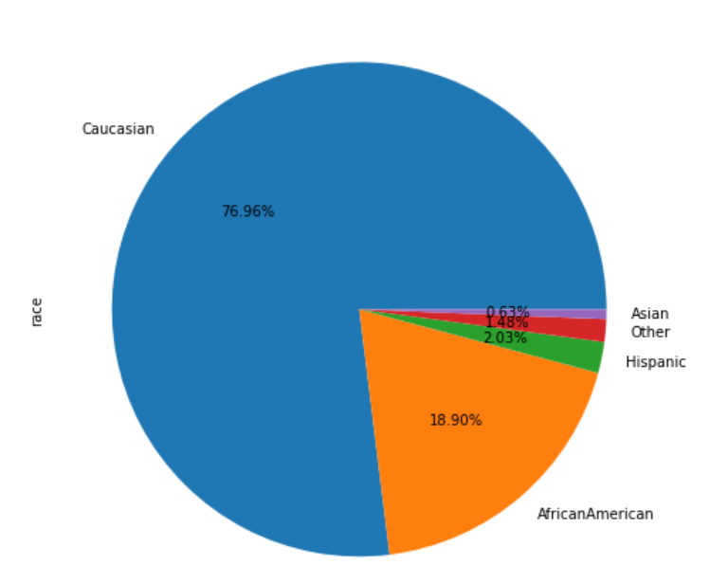
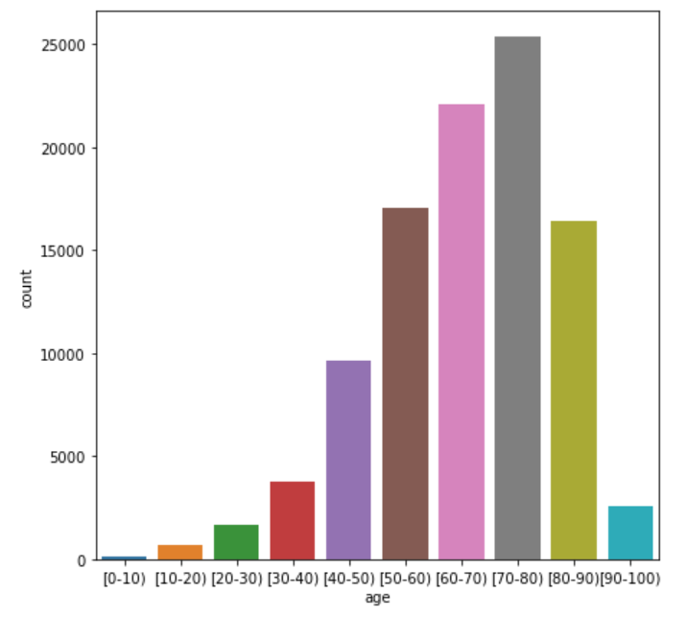
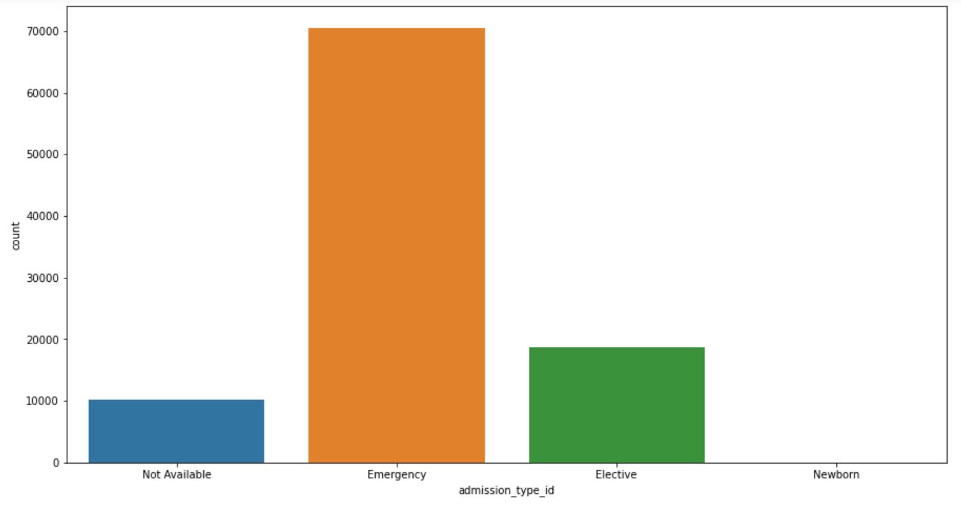
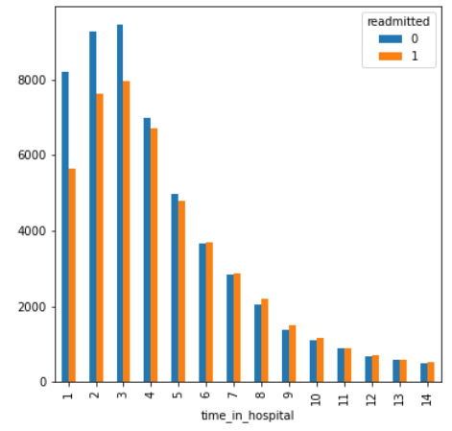
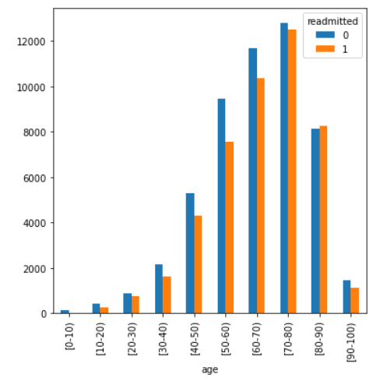
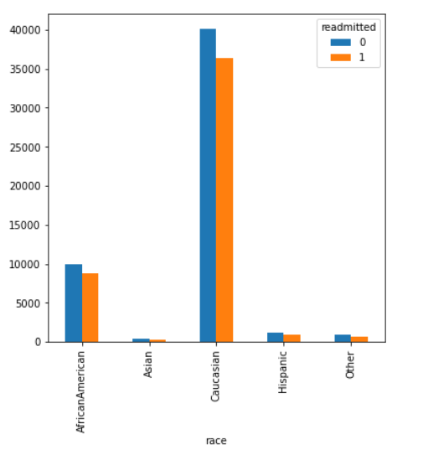
EXPLORATORY DATA ANALYSIS
UNIVARIATE
RACE
AGE
ADMISSION TYPE ID
BIVARIATE
TIME IN HOSPITAL VS READMISSION
AGE VS READMISSION
RACE VS READMISSION

Slide 5

Data pre-processing
FEATURE ENGINEERING
STEP
Creating New Features and Dropping Redundant Ones.
05
STEP
ENCODING
04
Different encoding techniques used to encode categorical variables.
INCONSISTENCIES
STEP
Data inconsistencies compromise data integrity and alter the performance of the algorithm.
03
STEP
COMBINING CATEGORIES
02
Merging multiple values in the columns giving similar inferences
MISSING VALUES
STEP
Dropping rows and columns wherever necessary.
Imputing missing values
01

Slide 6
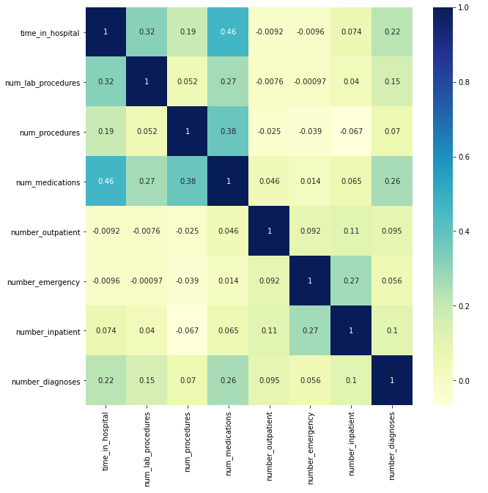
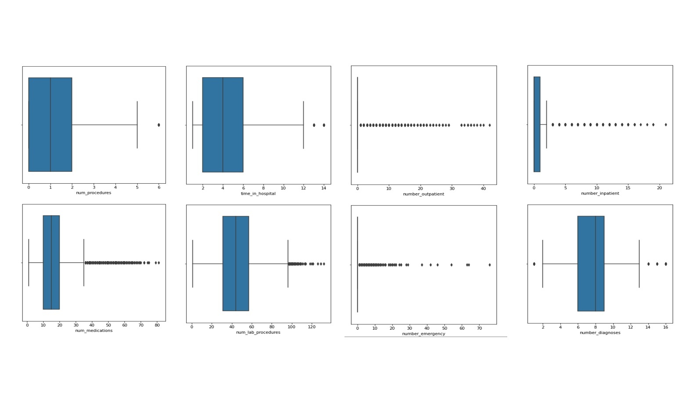
STATISTICAL SUMMARY
We had 43 independent features out of which 35 were categorical and 8 were numerical. After statistical analysis :-
23 out of 35 categorical features came to be significant. (Chi-Square)
All 8 of the numerical features came to be significant. (ANOVA)

Slide 7
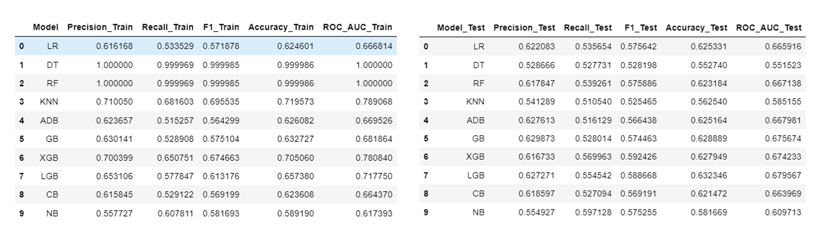
BASELINE MODEL
Primary Evaluation Metric: Recall
We used tree based algorithm because Logistic Regression model suffers from limitations like linear relationship, outliers and multi-collinearity.

Slide 8
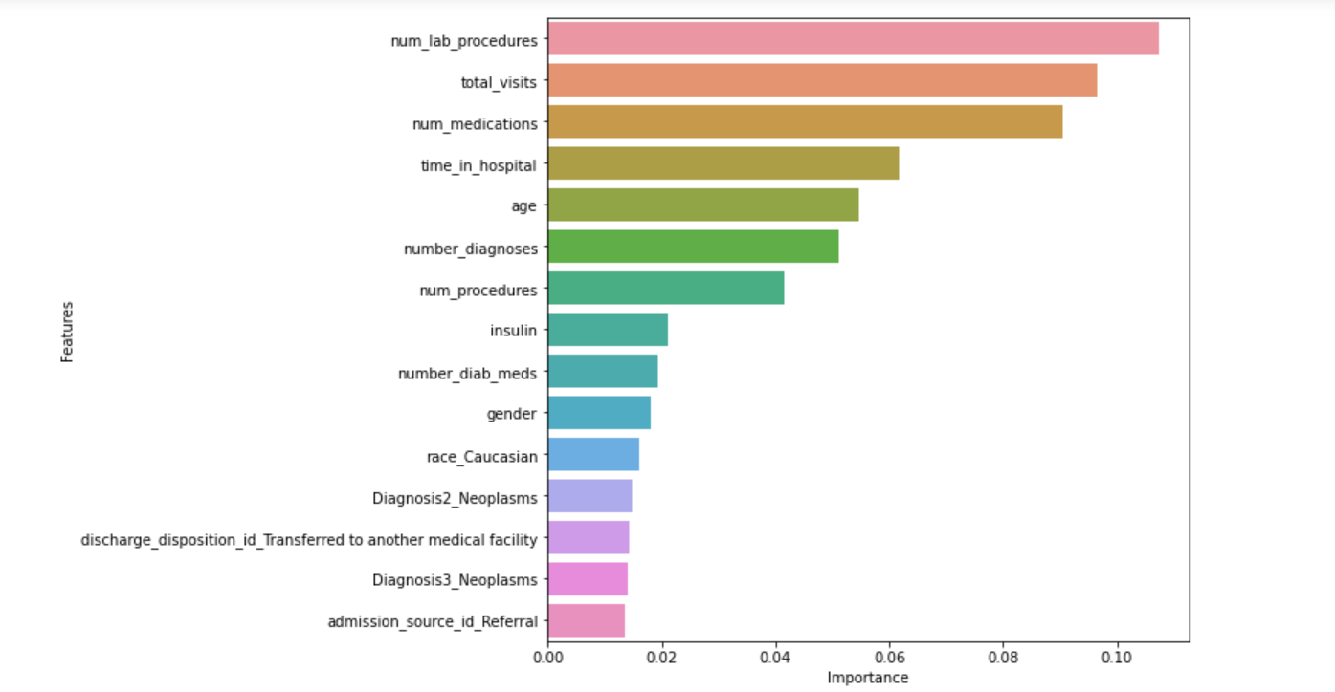
FEATURE SELECTION
STATISTITCAL TEST
RFE
FEATURE IMPORTANCE
TECHNIQUE USED

Slide 9
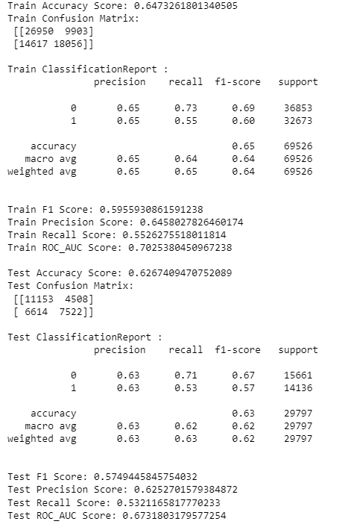
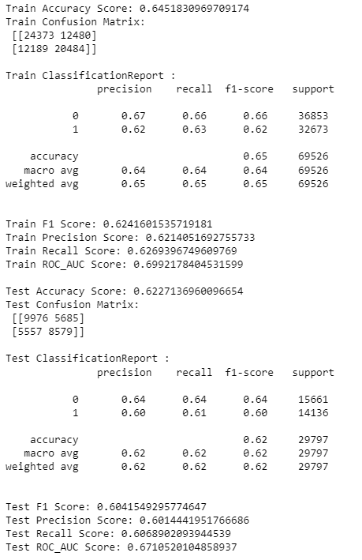
MODELLING RESULTS BEFORE & AFTER TUNING
BEFORE TUNING
AFTER TUNING

Slide 10
FINDINGS
CHALLENGES
ENCOUNTERED
The major challenge was to
acquire sufficient domain
knowledge of
the medical world.
Computation time
(Large Dataset).
Class imbalance which would
result in incorrect predictions.
If the patient has the following characteristics he has a high probability of being readmitted :
High preceding year visits.
If the patient is discharged to another medical facility or discharged to home with health services.
High number of diagnoses.
If the patient is given diabetes medicines.
If the primary diagnosed disease was of circulatory system.

Slide 11
BUSINESS RECOMMENDATION
A follow-up with the discharged patients should be done to keep a track of their health and to counsel them from time-to-time.
High-risk patients' current medicines' regime should be re-evaluated and the most effective medicines should be considered.
The annual plans, financials and infrastructure / inventory should be planned accordingly by taking into account the predicted readmissions.
Providing extra attention and care to high-risk patients.

Slide 12

THANK YOU

